Slide 1

Inequality in America
Professor Meyer
Notes:
What is prejudice?
Why does prejudice exists?
Are women highly regarded in your society? Why?
Are men highly regarded in the community?
Are there gender role biased issues in your country? What are they? Are women workers often promoted at their workplace?
If yes, what qualities do they possess over the other gender?
If not, what make them not excel at their work?
Do gender issues affect the development of a country?
Why do you think we need to discuss issues about gender?
What are some prejudices you have?
What prejudices have you acquired?
What, if any, measures has your national government implemented to combat gender-based discrimination or prejudice?

Slide 2
Equality
Ideal: “All men were created equal”
Reality:
  institutional racism
  racial discrimination (racism)
  gender discrimination (sexism)
  sexual orientation discrimination (homophobia)
  age discrimination
  discrimination against people with disabilities

Slide 3
Stereotypes
Can you guess their stereotypical occupation?

Slide 4
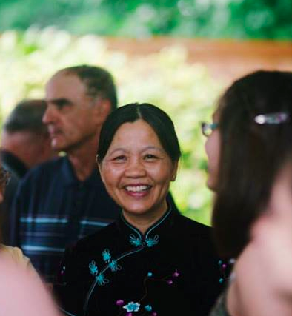
What is her occupation?
Engineer
Stay-at-home mom
English teacher
Librarian

Slide 5
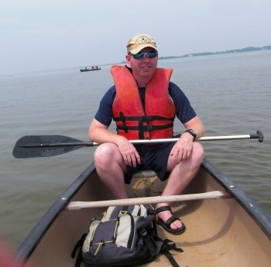
What is his occupation?
Stay-at-home dad
Canoe instructor
Lifeguard
Engineer

Slide 6
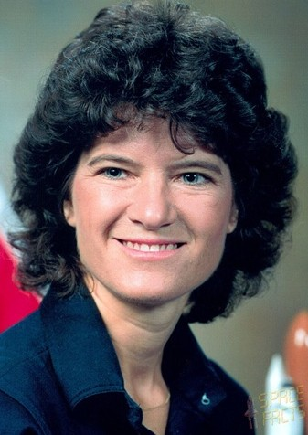
What was her occupation?
Actress
Astronaut
Deep sea diver
Business CEO

Slide 7
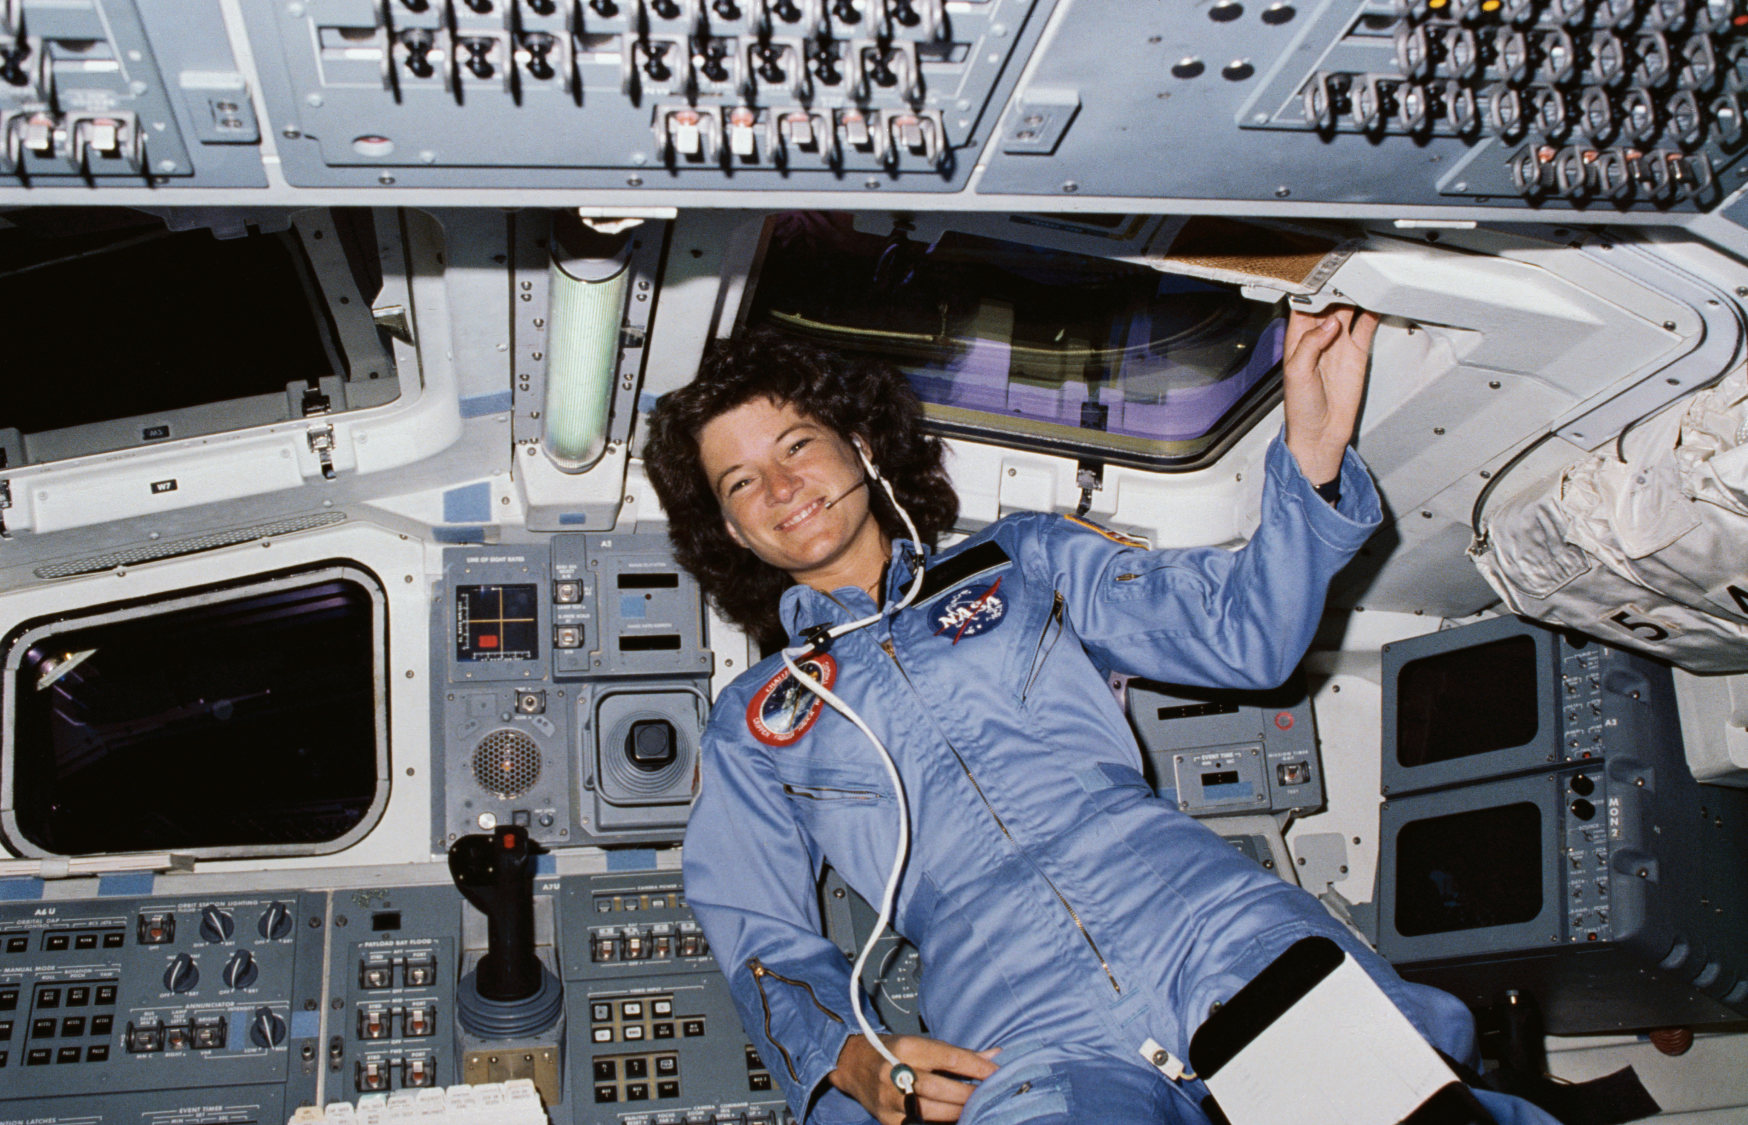
First female astronaut-Sally Ride

Slide 8
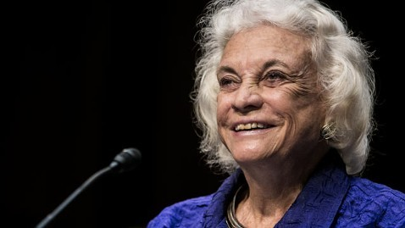
What was her occupation?
Retired politician
Retired school teacher
Retired stay-at-home mom
Retired judge

Slide 9
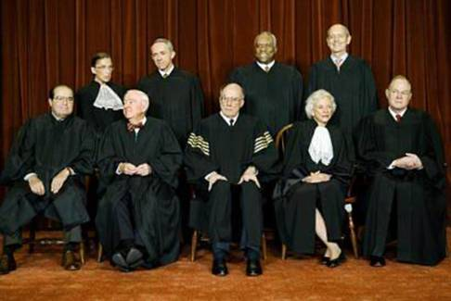
First female Supreme Court Justice

Slide 10
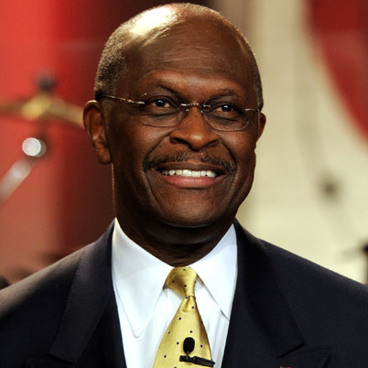
What is his occupation?
Business man
Politician
Principal
Church pastor

Slide 11
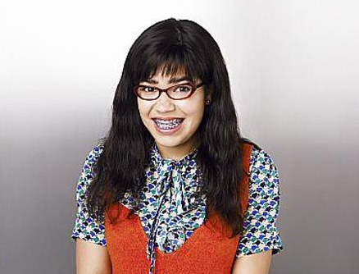
What is her occupation?
Librarian
Soccer star
Actress
Student

Slide 12
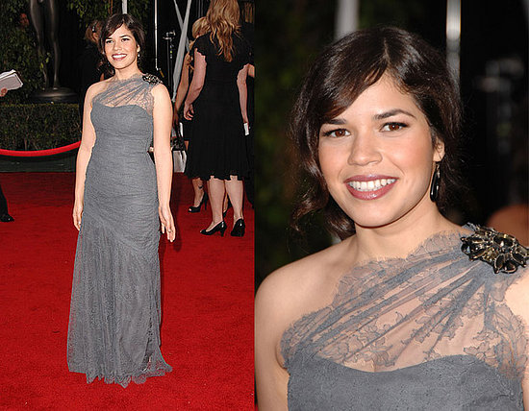
C. Actress

Slide 13
Stereotypes
It is natural to have stereotypes, but it is bad when they become prejudice.
  Stereotype: Hispanic Americans stereotypically hold low wage jobs.
  Prejudice: Hispanic Americans are not smart enough to hold a high wage job.
  Statistic: African American men have the highest incarceration rate of any ethnic group.
  Prejudice: African American men are criminals.

Slide 14
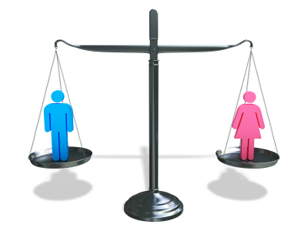
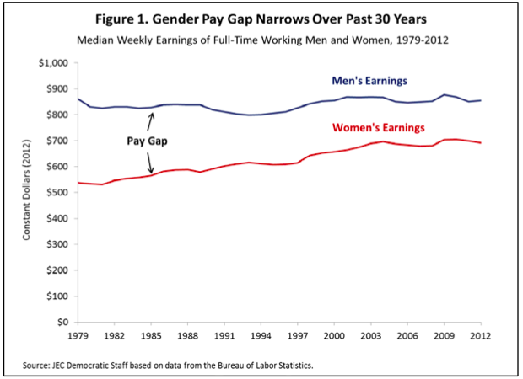
Sexism
Gender roles
Gender gap
  Job
    Pay gap
  Education
  Health
    Contraception
    Abortion
  Politics
Notes:
Do you see yourself as a typical man or woman? Why or why not?
In your country are the responsibilities of a mother the same as the responsibilities of a father to their families?
What are the responsibilities of a father to his family?
What are the responsibilities of a mother to her family?
Are fathers capable of carrying out the duties of a mother and vice versa?
Are there different expectations for sons and daughters?
What habits are deemed as appropriate for men but inappropriate for women?
What behaviors are deemed as appropriate for men but inappropriate for women?
What jobs are deemed as appropriate for men but inappropriate for women?
Are more doctors female or male in your country?
Are more nurses female or male in your country?
Are more professional musicians female or male in your country?
Are more teachers female or male in your country?
Are more truck drivers female or male in your country?
Are men and women equal in ability and intelligence?
What things can either men or women do that the other cannot do and why?
What type of clothing do men wear?
What type of clothing do women wear?
Can men wear women's clothing or can women wear men's clothing? Why or why not?

Slide 15
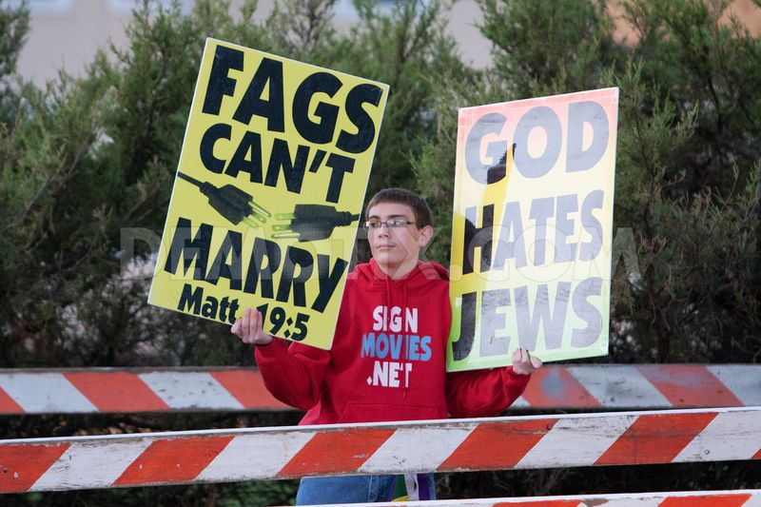

Homophobia
Hate crimes
Religion
  Westboro
  Baptist Church

Slide 16
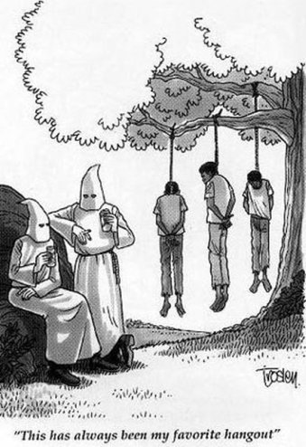
Racism
Hate crimes
  Lynchings
  KKK; “skinheads”
Affirmative actions
  Job
  Education
  Can lead to
  “reverse discrimination”

Slide 17
History of Racism
1876-1965: Jim Crow Laws
  “Separate but equal”
  Segregation
1896: Plessy v. Ferguson
  Segregation is OK for public schools
1954: Brown v. Board of Education
  Desegregation
  Segregation is unconstitutional
1990-current: NYPD’s Stop-and-Frisk Program
  The law does not formally target minorities, but the vast majority of people stopped are Hispanic or Black.

Slide 18
NYPD: Stop and Frisk
Police brutality is the deliberate use of excessive force, usually physical, but also in the form of verbal attacks and psychological intimidation, by a police officer.
Suspicious: having or showing a cautious distrust of someone or something
Controversial: giving rise or likely to give rise to public disagreement
Stop-and-frisk program: (of a police officer or other official) pass the hands over (someone) in a search for hidden weapons, drugs, or other items
Harassment: aggressive pressure or intimidation
Civilian: a person not in the armed services or the police force
Mutt: (derogatory) a person of mixed descent
Racial profiling: the use of race or ethnicity as grounds for suspecting someone of having committed an offense
Notes:
0:20
1:00
1:33
2:30-6:36

Slide 19
Giving a Presentation
Repeating v. summarizing
Do not read directly from your notes!
Try to make eye contact with the audience.
Use pauses and emphasis to sound more fluent and keep your audience engaged.
Make your presentation interesting!

Slide 20
In your 2 minute presentations…
Define any words that are unknown
  Raise your hand if you need help with a word
Summarize the main points article
  Summarizing the article v. summarizing the main points of the article
Give your opinion on the matter
Are there similar problems in China?
  A short example

Slide 21
Homework
Meet with your group
Do some research (and record your sources)
Decide on a thesis and your supporting argument
Work on creating presentation

